Slide 1
Membership Renewal
2026
Instructions for group administrators

Slide 2
Membership period and fees
A group membership renews automatically on a yearly basis for the period January until December.
Full group membership fee are due for the calendar year in which you applied for a group membership (no pro-rata group membership fees).
Only the Group Administrator of your group membership can renew the members in your group. If you are not sure who this is for your group, please contact us by email to membership@iiabelgium.org
2026 Group Membership Fees
1 | € 240
2-9 | € 220 per extra member
10 < | € 150 per extra member

Slide 3
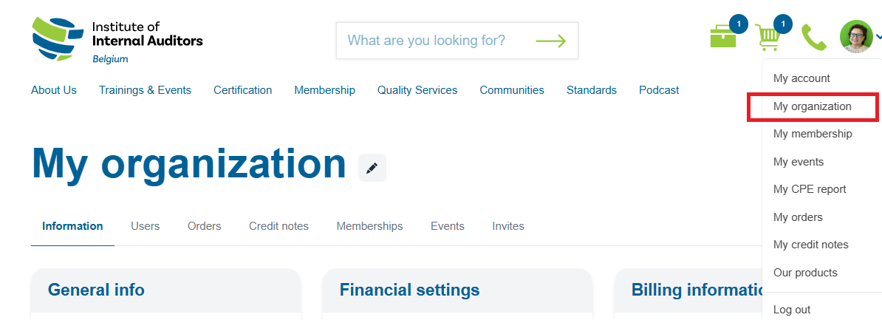
Access to your group page
Sign in to the page www.iiabelgium.org
Go to the right upper corner of your screen and select ‘My Organisation’.

Slide 4
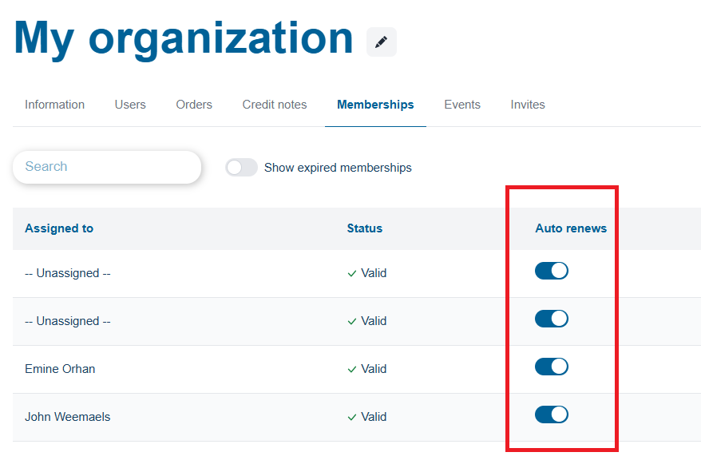
Renew your group membership
All membership levels are set to auto-renew.
If you enable the automatic renewal, your group membership subscription will automatically renew on January 1, 2026.
When you disable the automatic renewal function of someone, the membership will be deactivated on December 31, 2025.

Slide 5
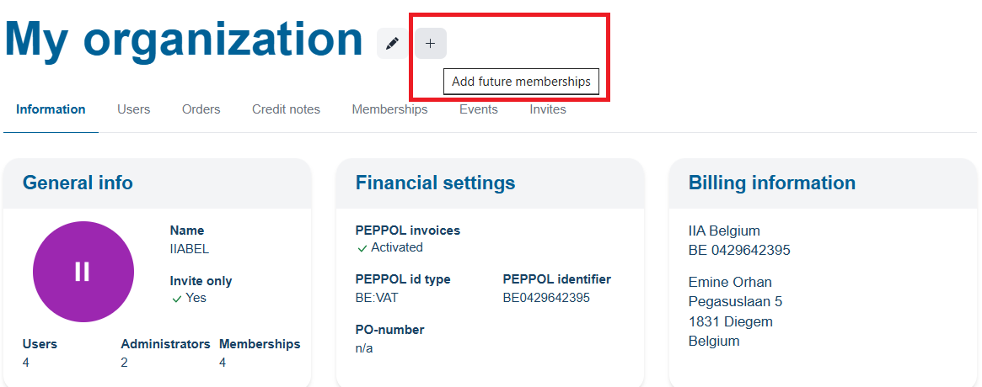
Add more credits to your group membership
Click on the + sign next to ‘My organization’ to upgrade your group membership.

Slide 6
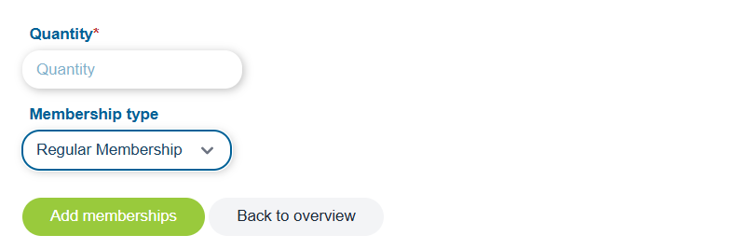
Add more credits to your group membership
Enter the quantity of credits that you need for your group membership and click on ‘Add memberships’.
Your newly added credits will only be available as of January 2026.
Go to slide 11 to learn how to assign or reassign a membership.
Add memberships for 2026

Slide 7
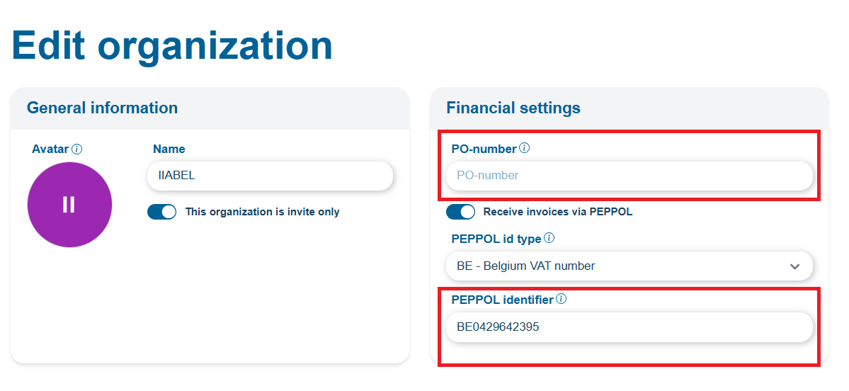
Add PO number and activate PEPPOL
Click on the pencil next to ‘My Organization’ and check :
If the invoice for your 2025 membership needs to include a PO#, please include it here.
If you want to receive PEPPOL (electronic) invoices, please include your unique identifier (for Belgian entities, in most cases it is your VAT#).

Slide 8
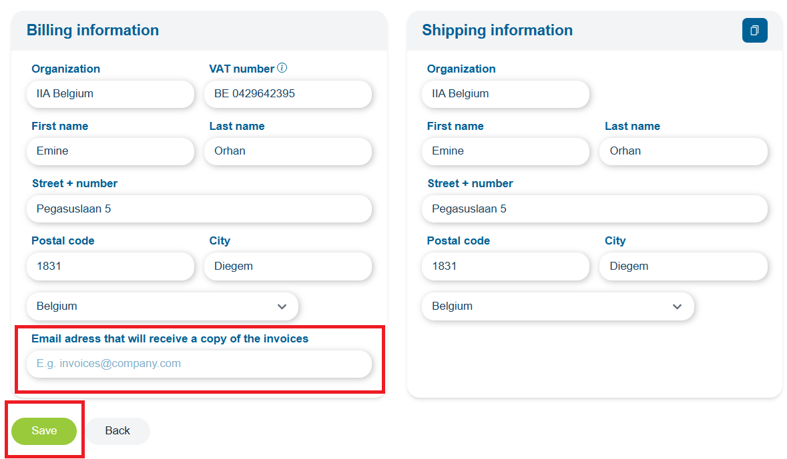
Verify your billing address
Also make sure your billing details are correct and save all changes.
Under My Organization/Membership, make sure to review all the members for your group (if applicable) and re-assign, add, remove members where necessary.
To avoid confusion, do not add additional (accounting) e-mail addresses if you enabled PEPPOL invoicing.

Slide 9
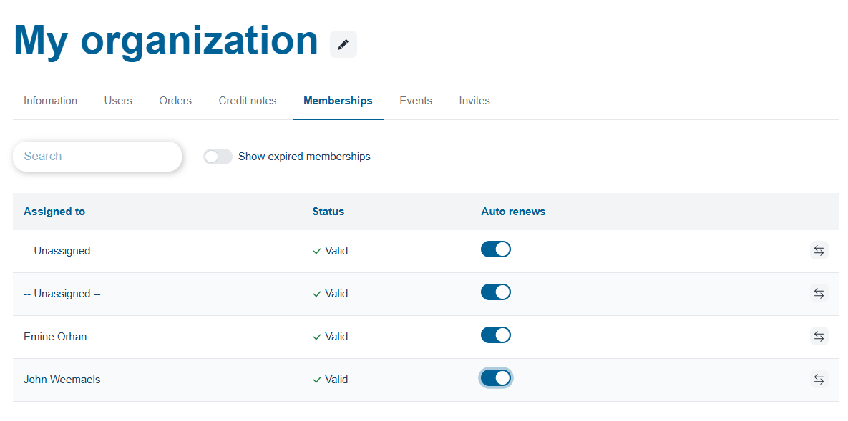
Review your member list
Make sure to review all the members for your group and re-assign, add, remove members where necessary.

Slide 10
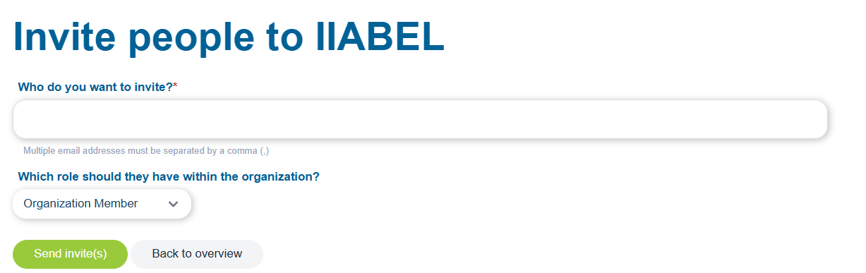
Invite new member(s)
Only administrators can invite new members to their group membership.
Go to ‘My Organisation’ - ‘Invites’ , click on the + sign and enter the email address of the (new) member(s) who need to be included in your group membership.

Slide 11
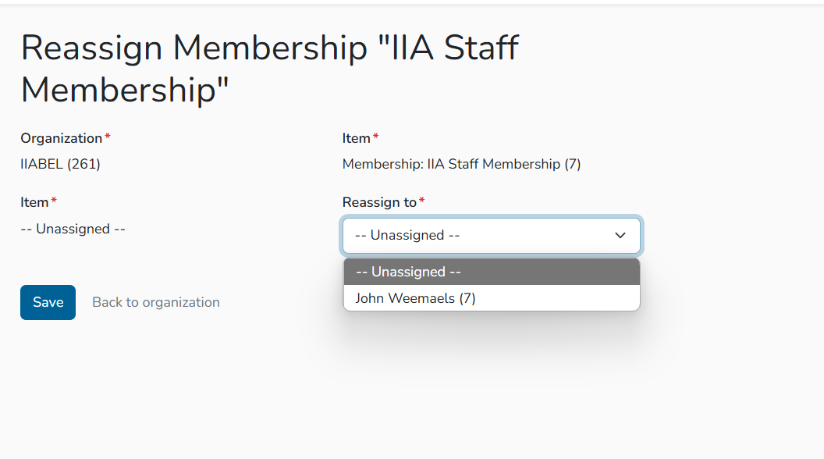
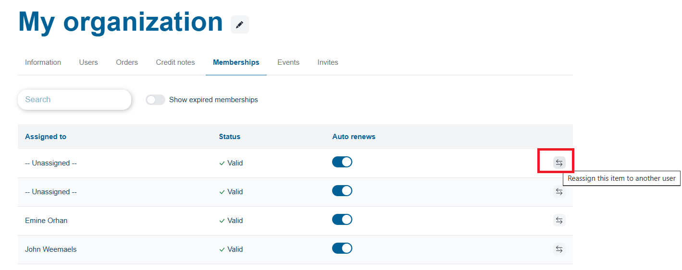
Assign or reassign a membership
For members leaving an Internal Audit group membership during the membership year, no reimbursement will be made, but replacements are possible without any additional costs.

Slide 12
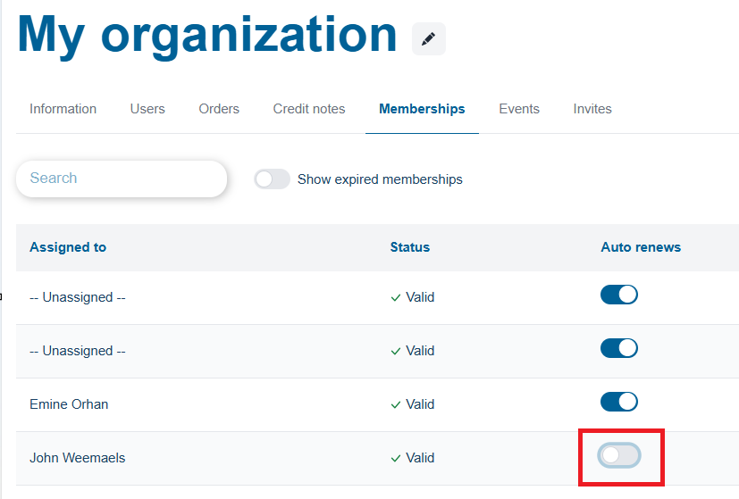
Cancellations group membership(s)
To disable the auto-renew function:
Go into your profile and turn the auto-renew off before December 31, 2025.
The group membership subscription will automatically be deactivated on December 31, 2025.

Slide 13
Contacts
Email: membership@iiabelgium.org
Phone: +32 2 887 31 39

Slide 14
Other Membership types
If you are a Chief Audit Executive you can become member of our Chief Audit Executives Club at an annual rate of 990 euro.
For the exclusive advantages of this membership, or if you have more questions, please contact us by email to Cedric.Hamaekers@iiabelgium.org
Updated 28/10/25

